Slide 1

Turning Sales Data into Actionable Business Insights
GoldVista — Sales & Business Analytics Dashboard
POWER BI
SQL
PREPARED BY AJIMOL .SHAHEER

Slide 2

High Transaction Volume Requires Faster Business Visibility
GoldVista operates across multiple branches, product lines, customer segments, and sales teams — generating significant daily transaction volume. A centralized, interactive dashboard was needed to monitor performance in real time and surface actionable opportunities.
352.56M
Total Revenue
62K
Total Invoices
2.62M g
Total Weight
1.72%
Return Rate

Slide 3
Five Critical Business Questions Drive This Analysis
Every insight in this dashboard traces back to a core operational question — ensuring analysis stays focused on decisions that matter.
1
Revenue
How is overall revenue performing across the business?
2
Branches
Which branches contribute most to business performance?
3
Products
Which item types and karats drive sales?
4
Customers
How effectively is the business retaining customers?
5
Returns & Buy-Back
Where are returns and buy-back activities concentrated?

Slide 4
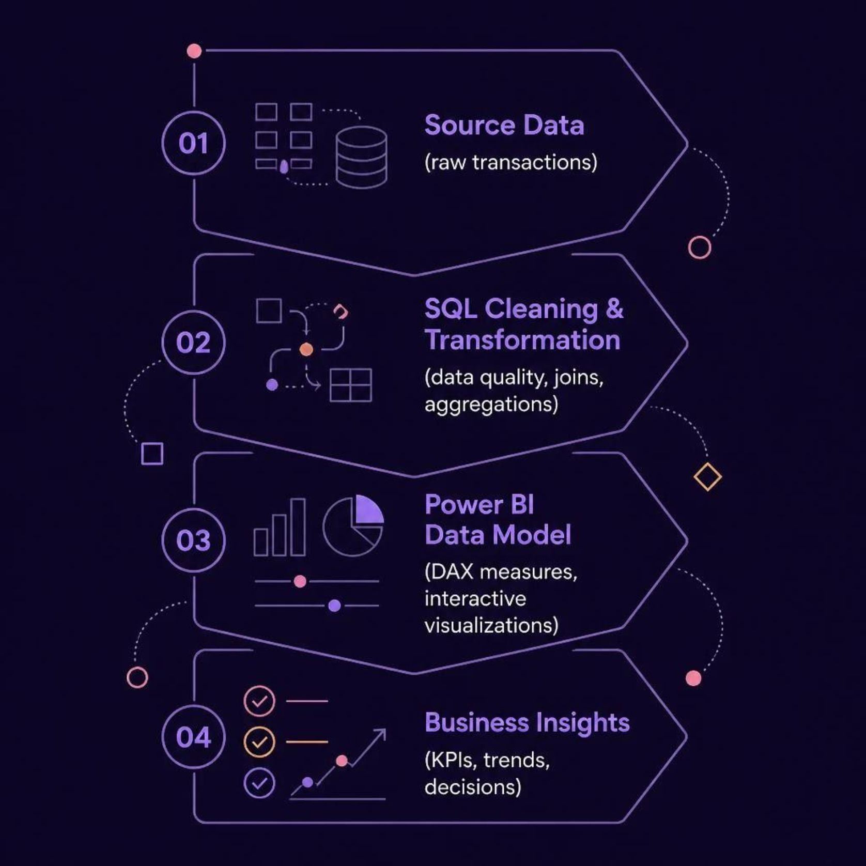
SQL Transforms Raw Transaction Data into a Business-Ready Dataset
A structured data pipeline ensures every insight is grounded in clean, validated, and business-ready data — from raw transactions to interactive dashboards.
SQL
PostgreSQL
Power BI
DAX
Cleaning & Joins
Query Engine
Visualization
Business Logic

Slide 5

352.56M Revenue Across 62K Invoices — Establishing the Business Baseline
352.56M
Total Revenue
62K
Invoices
2.62M g
Weight Sold
1.72%
Return Rate
Average invoice value stands at 5.67K, while Old Gold Buy-Back activity totals 143.75K — a key secondary revenue stream. The dashboard provides an executive summary view drilling from KPIs through revenue trends, branch performance, division breakdowns, and karat analysis.

Slide 6
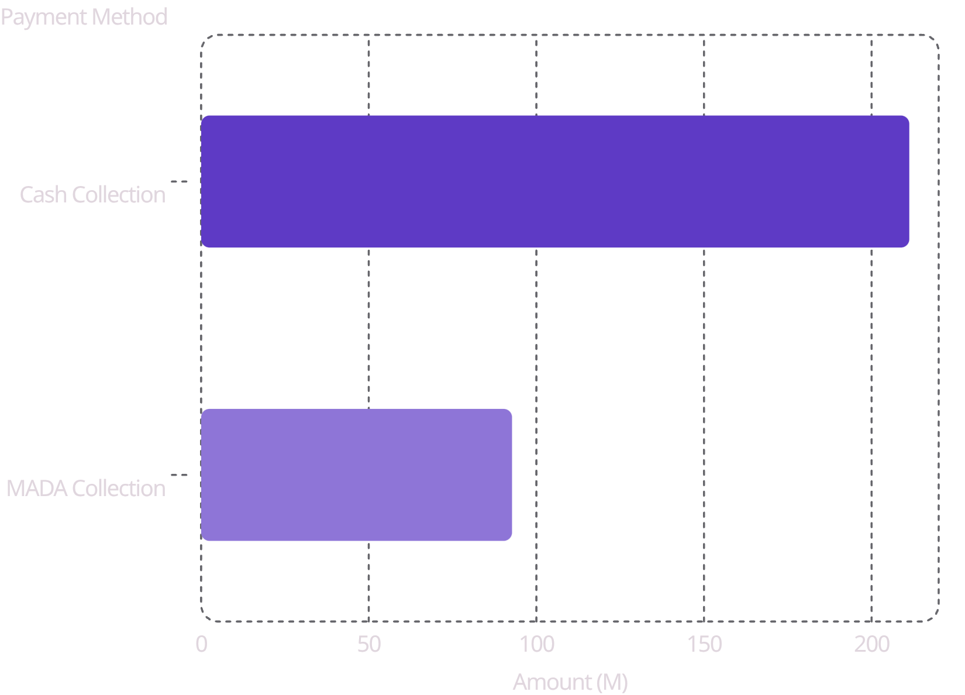
Branch, Salesperson & Payment Analysis — Where Revenue Is Generated
Payment Method Split
Key Findings
Cash dominates at 211.23M, representing the majority of collections
MADA payments contribute 92.73M — a growing digital channel
Top salesperson generated 24.05M in individual revenue
Branch ranking, karat mix, and salesperson performance are all drillable in the live dashboard

Slide 7




Product & Karat Analysis — What Drives Sales
Understanding which item types and karats perform best enables smarter inventory, pricing, and merchandising decisions.
Item Type Analysis
Revenue breakdown across rings, chains, bracelets, and other categories — identifying top sellers and underperformers.
Karat Performance
Sales distribution by karat grade reveals customer preferences and margin opportunities across the product range.
Discounts & Making Charges
Monthly revenue trends alongside discount rates and making charges help optimize pricing strategy.

Slide 8
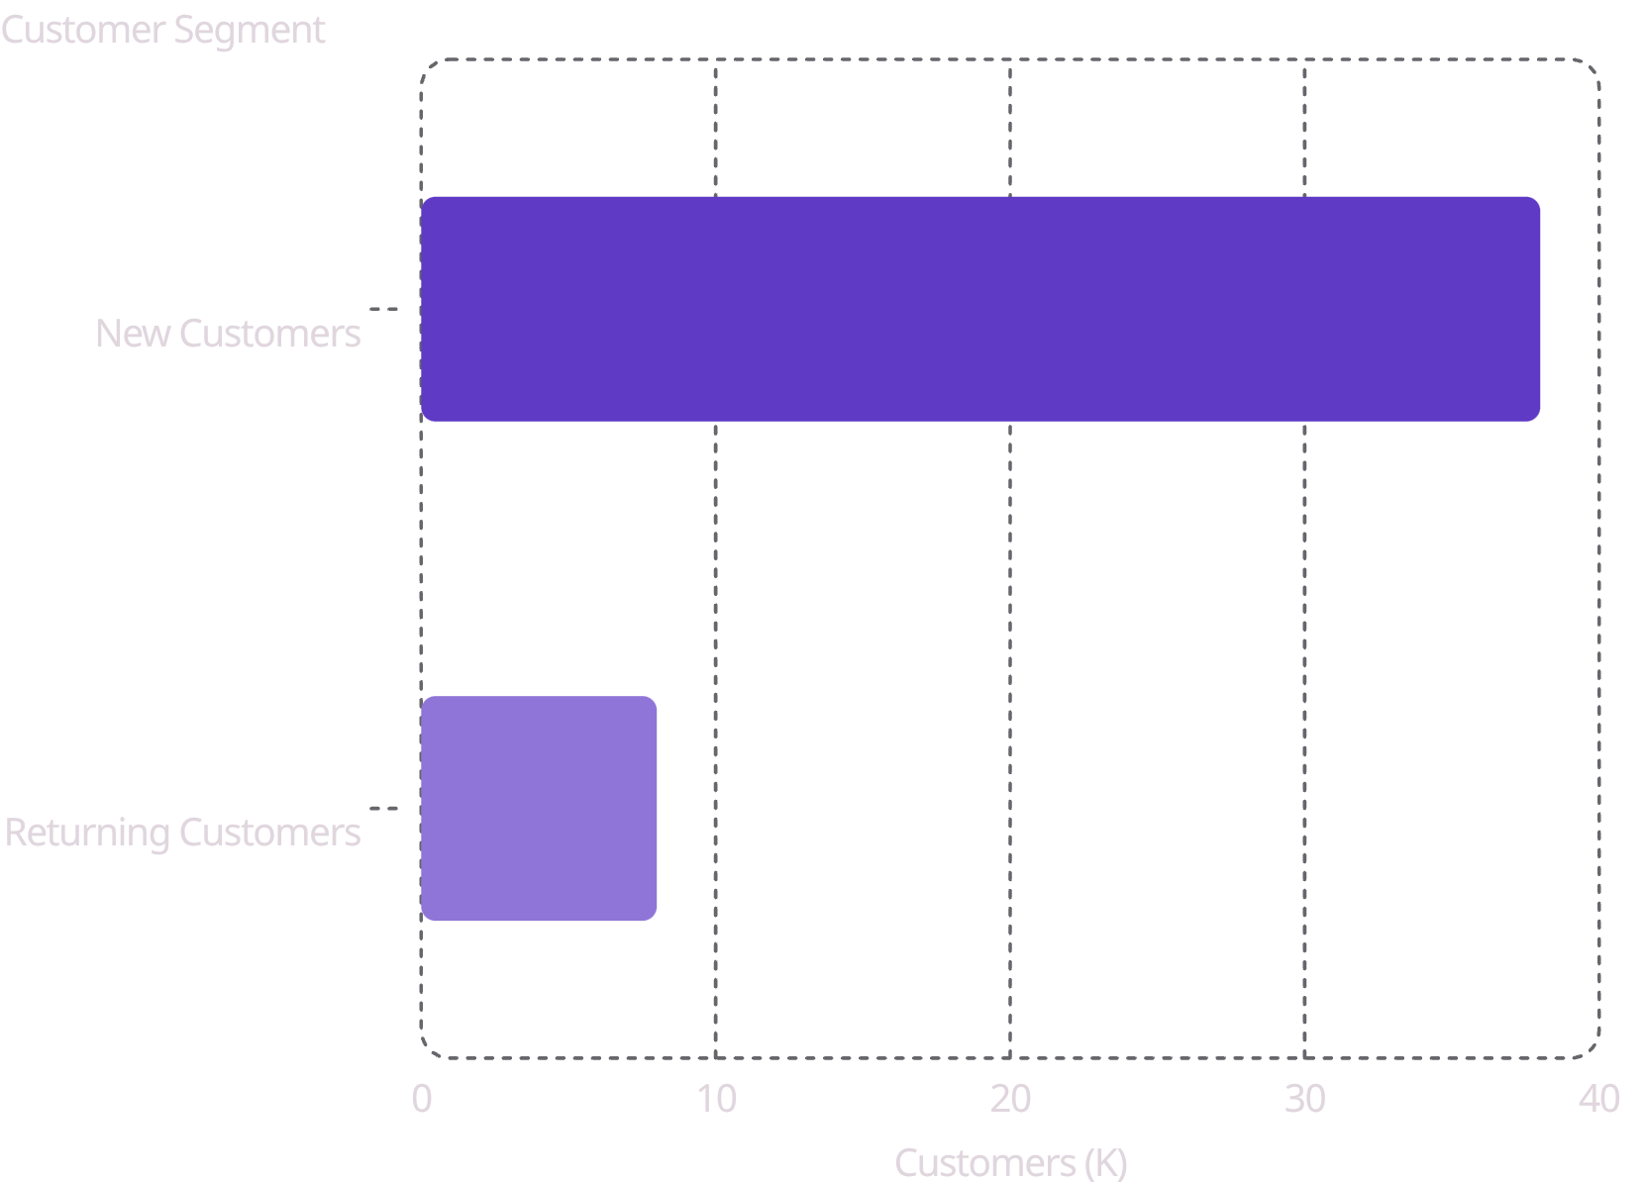

Only 16.55% of Customers Return — A Major Retention Opportunity
Customer Intelligence
Of 46K total customers, only 7.73K (16.55%) are repeat buyers — while 83.45% are one-time purchasers. This represents the single largest growth lever for GoldVista.
38K New Customers
8K Returning Customers
Acquired but not yet retained
Average lifetime value tracked

Slide 9
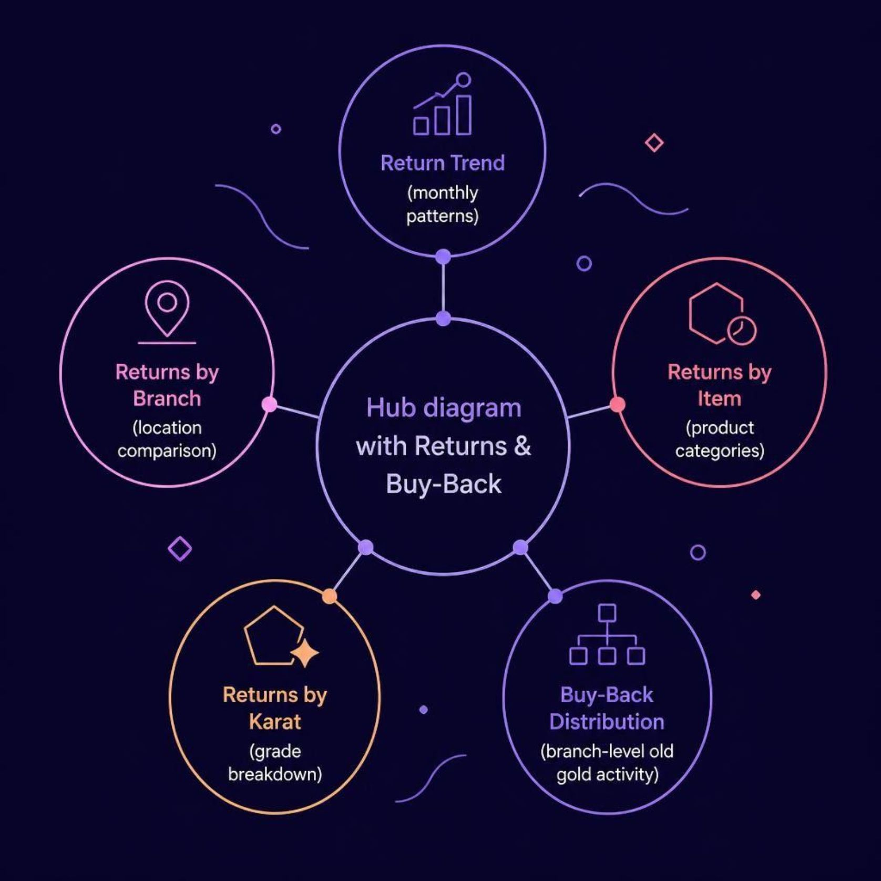
A 1.72% Return Rate Requires Continuous Monitoring
Return & Buy-Back Overview
While the overall return rate is low at 1.72%, branch-level and item-level patterns require ongoing surveillance to prevent escalation. Old Gold Buy-Back activity of 143.75K is a significant secondary flow that must be tracked separately.
Return Trend
By Branch
By Item & Karat
Buy-Back
Monthly movement
Location comparison
Product patterns
Branch distribution

Slide 10
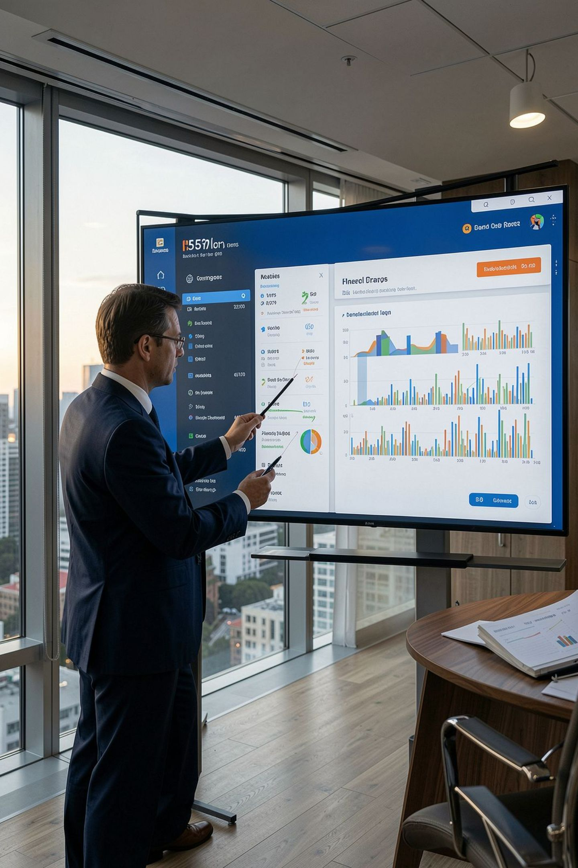

Customer Retention Is the Clearest Growth Opportunity
1
Increase Repeat Customers
Loyalty programs, targeted follow-ups, and personalized offers
2
Improve Branch Performance
Benchmark branches, replicate best practices, address underperformers
3
Strengthen Product Decisions
Use item & karat insights, review discounts, monitor making charges
4
Monitor Returns Proactively
Branch-level tracking, item investigation, pattern detection
Key Takeaway: GoldVista can move from reporting what happened to acting on what happens next — with automated refresh, alerts, forecasting, and retention analytics on the roadmap.

Slide 11




The Dashboard Enables Faster Decisions from Executive KPIs to Operational Detail
GoldVista's new analytics dashboard empowers stakeholders to make informed decisions quickly, transitioning from reactive reporting to proactive strategy.
What GoldVista Gains
Future Scope
Executive performance visibility
Branch & salesperson comparison
Product & karat insights
Customer intelligence
Return & buy-back monitoring
Interactive decision support
Automated Refresh
Alerts
Forecasting
Customer Retention Analytics

Slide 12
GoldVista Can Move from Reporting What Happened to Acting on What Happens Next
Here's a quick recap of the critical metrics driving this transformation:
352.56M
62K
Revenue
Invoices
16.55%
1.72%
Repeat Customers
Return Rate
Thank You
Questions?

